Slide 1
Tools and Projects
Portfolio
Dr Farraen Mohd Azmin
Feb 2022

Slide 2
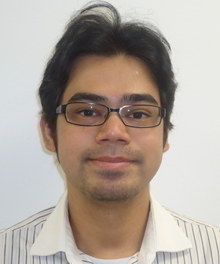
Dr Farraen Mohd Azmin
Responsibilities:
Develop tools for automotive applications
Software owner of MPT (Model Parameterisation Tool)
Software owner of Ricardo Trace
Past and ongoing projects involvement:
Dynamic Model algorithm development for Efficient Calibration Toolset
Big Data Project
Connected BMS
Controller Optimisation
SCC Cloud project
Awards and Achievements
Ricardo Phil Hore Engineering and Science Excellence Awards 2021 – Runner up
Ricardo Technical Paper of The Year 2017
Ricardo Engineering and Science Excellence award 2017 – Runner up
Awarded full scholarship from Proton Holdings to pursue automotive engineering degree
Senior Project Engineer: Machine Learning Specialist
Methodology Group
Software, Controls and Calibration

Slide 3
R-Drive
A tool with GUI to extract acceleration data from vehicle recording and convert them into acceleration map. Reduce time from two-weeks of manual processing to 5 minutes.
R-Machine
Machine Learning toolset including custom regression tool and custom PSO optimisation.
Strategy Compare Tool
Developed tool for comparing Bosch strategy document diagrams
ML Model in Excel VBA
Developed function to convert Ricardo ML model (SPM) into VBA BAS modules and run ML predictions within Excel without Matlab or any other software
MDF Tool
MDF file read, write and data alignment tool
Software and Tool highlights
MPT
Simulink optimisation tool for calibration and control engineers
Performance Test Report Generation
A VBA script to extract dyno performance test results and compile it into a report
Graph Trace
Contour plot or map image digitalisation tool. The tool can convert a contour plot in 2 minutes. Otherwise can take one day to convert it manually.
Trace
Image to Simulink model digitalisation tool. The tool can convert models in minutes.
MPT
Simulink optimisation tool for calibration and control engineers

Slide 4
Simulink Optimisation
Developed own tool called MPT to optimise maps for controller and strategies
Optimisation
Have experienced in applying optimisation to various applications including map smoothing, controller optimisation, etc.
Testbed
Have experienced in operating AVL bobcat and Froude Cosine testbed in the past (more than 8 years ago)
Software development
Matlab and Python scripting
Matlab-based software full development and SW release
MVC and HMVC framework
Experience in dashboard (Dash) and JavaScript
Experienced in preparing pipeline and yml file for deploying scripts from VSCode to Gitlab CI/CD and finally to Kubernetes
Simulink Problem Solver
Helped calibration and control engineers to solve complex Simulink problems
Simulink Strategy Development
From PDF to Simulink model
Work Experiences
Image Processing
Experienced in converting images into data
Developed tool for converting images of maps and contour plots into numeric data
Object and line detection algorithms
Simulink Compilation
Experienced in compiling Simulink models to DLLs and FMUs
Data Generation
Used Monte-Carlo Simulation to develop artificial fleet data
Used damage model for a fuel system to develop realistic fleet data
Calibration
Worked a three years at engine test cell calibrating base engine maps
Converted 16-bit ECU to 32-Bit ECU
Calibrated a rotary engine at test cell from empty maps
Installed Motec racing to a research vehicle and prepared short harness
Machine Learning
Developed ML regression algorithm from scratch
Experienced in many various of ML models including neural networks, deep neural networks and reinforcement learning
Experienced in predictive maintenance
Simulink in XPC
Have embedded a Simulink model that can optimise engine maps in real-time in xPC for PhD research

Slide 5
Matlab toolboxes
Reinforcement
Learning
PyCharm
Spyder
Sklearn
GitLab CI/CD
AWS SageMaker
Kubernetes
VSCode
Keras
Jupyter
Docker
Machine Learning
IDE and Env
Azure (Basic)
Python
VBA
Deployment
AWS
Cloud
Programming
Language
Matlab
Dash Plotly
Simulink
Skills
Dashboarding
JavaScript
S-function
Model
FMU
Version control
Database
GitLab
Gradient (fmincon)
Model-based
Optimisation
Plastic SCM
DoE
Ricardo Efficient Calibration
Genetic Algorithm
Basic SQL scripting
Hybrid Optimidation
Statistical Model
ETAS ASCMO
PSO
Mathworks MBC

Slide 6





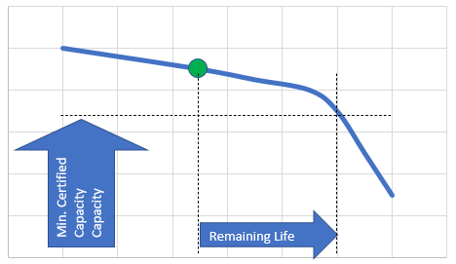

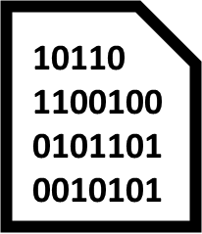








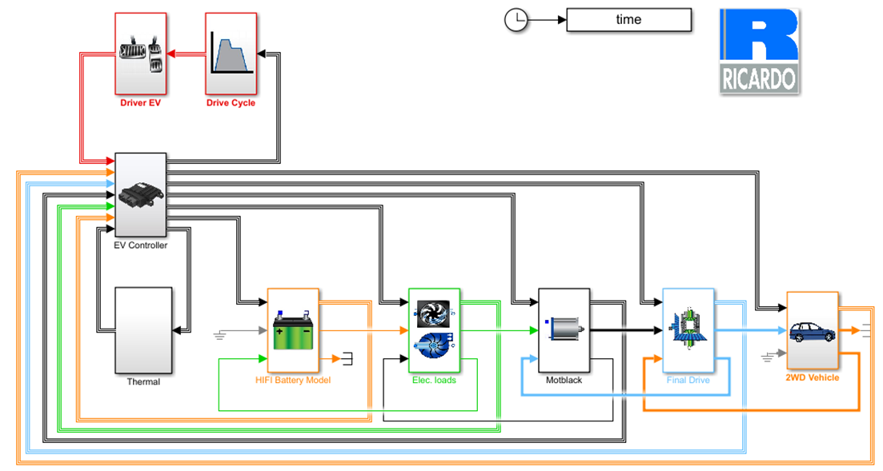
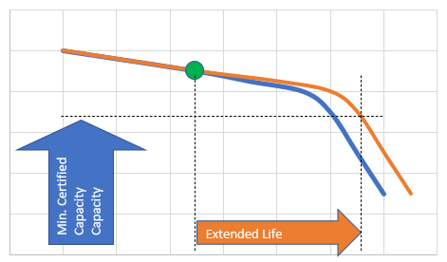

Connected BMS is a project to explore and develop a platform to use digital twin, Monte-Carlo Simulation, machine learning, database and dashboarding. The main purpose is to improve a fleet of electric vehicles life by providing targeted BMS updates.
Vehicle Fleet
Fleet Data + Service Records
Data Over The Air (DOTA) test platform allows to assess, evaluate and compare different data exchange techniques from BMS to cloud
BMS Updates
Fleet health monitoring
Fleet
SoH Data
Current state of health and predicted lifetime
New BMS Parameters
Database
Machine Learning Pipeline
SoC
Estimation
Optimisation
Power Availability Calibration
RUL, SoH
Minimum
Capacity
Data
Processing
Anomalies,
Failure
classification
Remaining
Life
Fleet Data
Fleet Digital Twin
Service Records
High Fidelity Model
Fleet prognostics
Digital Twin
SoH Prediction
Customer satisfaction
Database can be on a cloud services such as AWS or Azure, or local storage
Fleet Digital Twin
Model Training Algorithm
High Fidelity Model
Initial Training
Service
Records
List of vehicles at risk
Minimum
Capacity
Current prediction can be compared with actual fleet data interval service records for model retraining
Extended
Life
Software Over The Air (SOTA) test platform for assessing software & calibration update strategies
Potential state of health and predicted lifetime scenarios

Slide 7
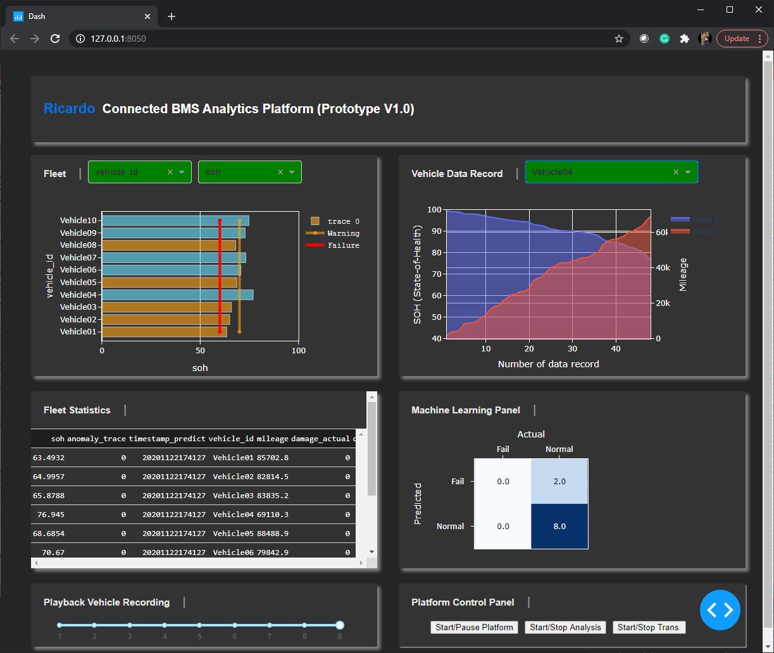
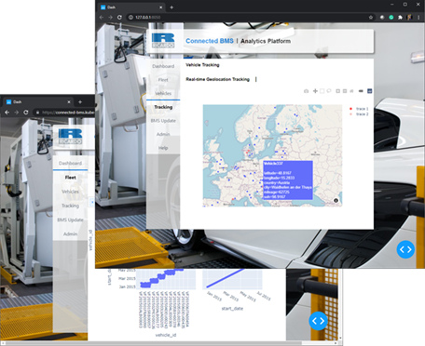
Some of my outcomes from the project:
Fast prototype platform developed in one week to test data transmission from a simulation fleet, to our PostgreSQL and connected to a simple dashboard
Platforms or packages used:
Fleet simulation – Python script with vehicle and fleet classes to simulate battery degradation (SoH)
2) Multi-processing scripts in python to run simultaneously at different rates (to simulate real data transmission frequency)
3) A ‘Dash’ dashboard to view fleet performance and health
Final dashboard connected to our machine learning platform and PotgreSQL databased. Using ‘Dash’ web framework that run on Python. Displaying fleet performance and vehicle location using MapBox for real-time tracking.

Slide 8
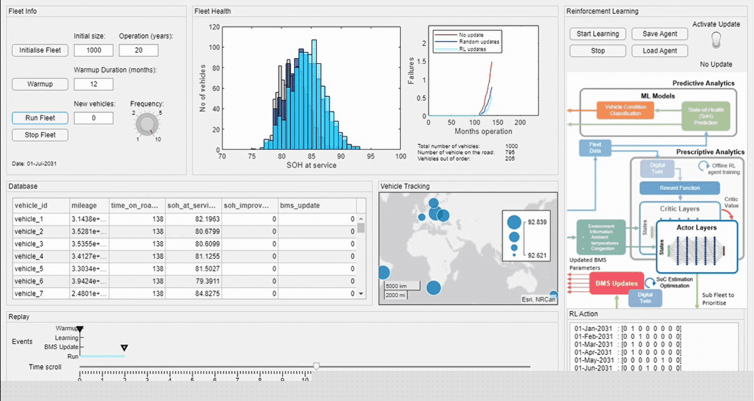
Some of my outcomes from the project:
I have developed a prototype decision engine using deep reinforcement learning to proof that prescriptive analytics can help to further improve fleet health using environmental factors. It took me two-weeks to develop:
The agent was trained using deep RL
Sends targeted BMS monthly updates by prioritising subfleets depending on congestion and ambient temperatures
An interactive dashboard to run the simulation, train the RL and compare the results

Slide 9
Monte-Carlo Simulation
Planned fMonte-Carlo simulation factors
My plan was used by the simulation team member to construct the vehicle fleet
MQTT Protocol
Used MQTT (An IoT protocol) to send and receive data using local broker and Azure IoT hub
Simulink to FMU
Converted Simulink models to FMU so that we can run on Python.
Other experiences gained from the project
Project management
Helped project manager to set machine learning tasks
Machine Learning Model
Helped to create initial ML model for the battery degradation model using real battery data
Database
Accessing PostgreSQL, view data and write simple scripts to get data
Webinar
Presented the project webinar with project director and manager.

Slide 10
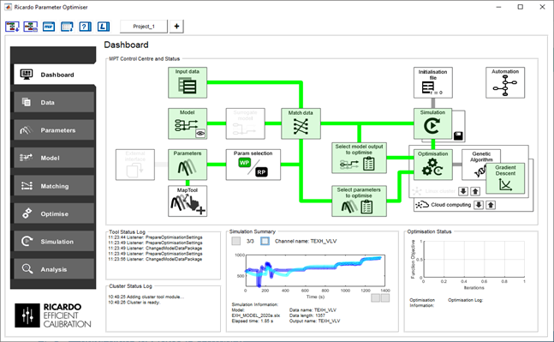

Model Parameterisation Tool (MPT) is a generic Matlab-based tool capable of emulating ECU strategy and populating ECU maps to match ECU model output to measured data.
The tool is now a standard Ricardo tool for optimising Simulink models for control system, strategies and modifying maps or parameters for control system.
MPT use advanced optimisation methods including hybrid optimisation and genetic algorithm.
I have developed this on my own since 2016 and has released 3 versions of the tool. I have written about 100k lines of codes for the whole tool.
I won runner-up for Ricardo engineering excellence award for the tool development.
Dashboard
Linux Cluster
One button operation for:
Data packing
Send to Linux cluster
Execute optimisation
View status and maps from Python-dashboard
Retrieve the optimised parameters from within MPT
I’m interactive

Slide 11
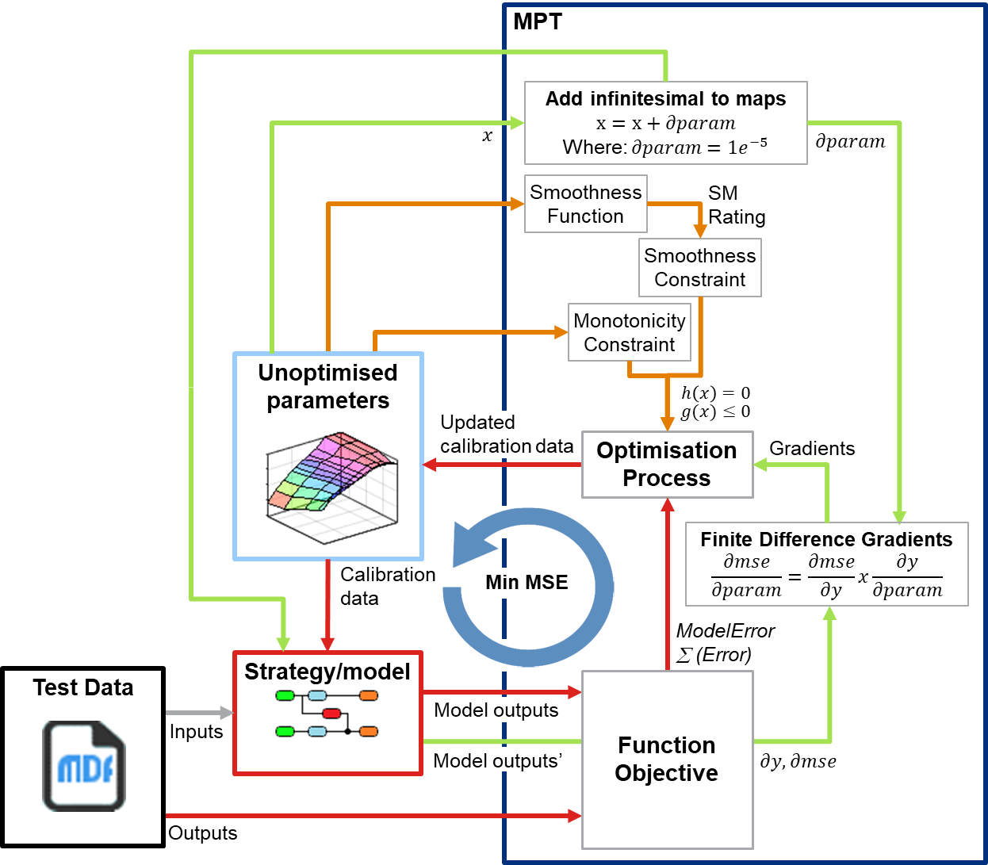
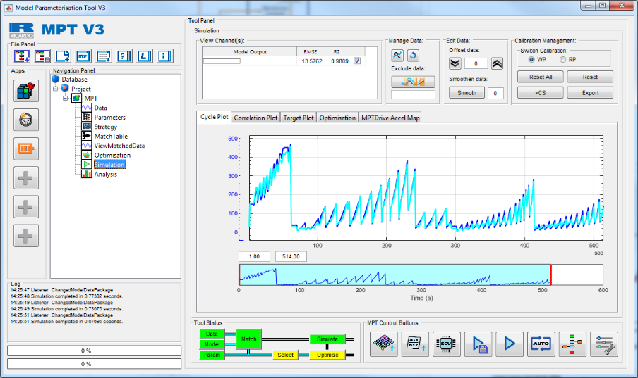
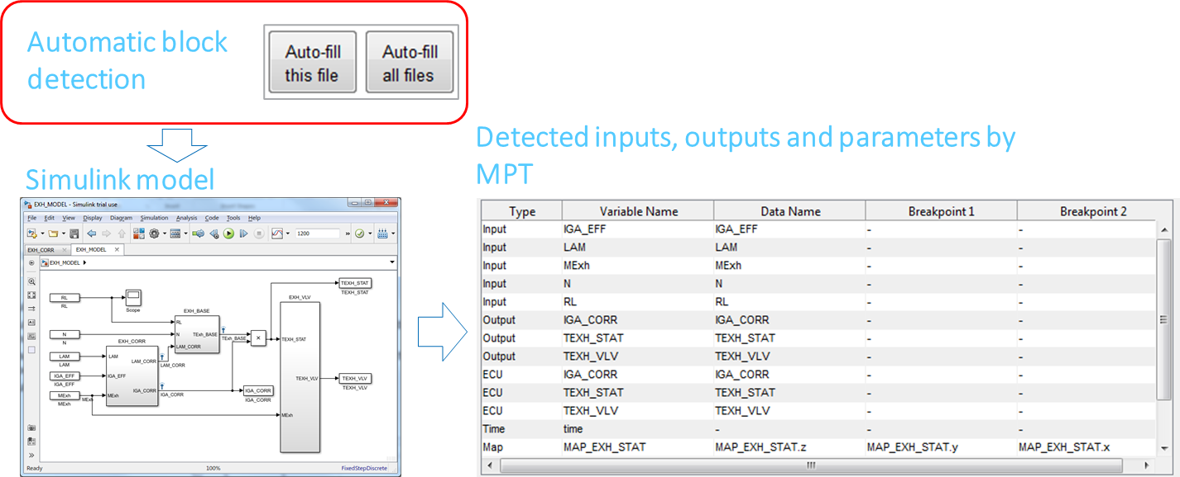
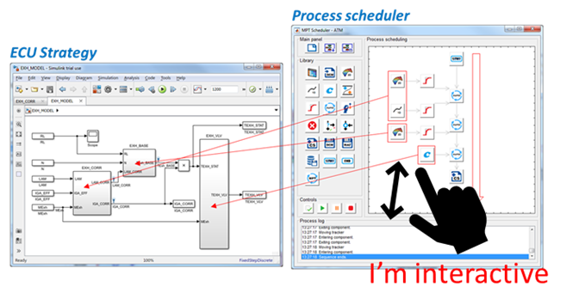
Simulink Optimisation
Using map smoothing and constraints, monotonicity constraints, finite difference gradients and boundary control to make sure parameters are optimised
Simulink Surrogate Modelling
Using ML model in Simulink to replace time-consuming subsystems to improve model run time
Other MPT features
Automatic Simulink Block Detection
Reduce engineer work to setup the model in the tool
Interactive Process Scheduler
Written entirely on Matlab common functions. Drag and drop style process scheduling programming

Slide 12
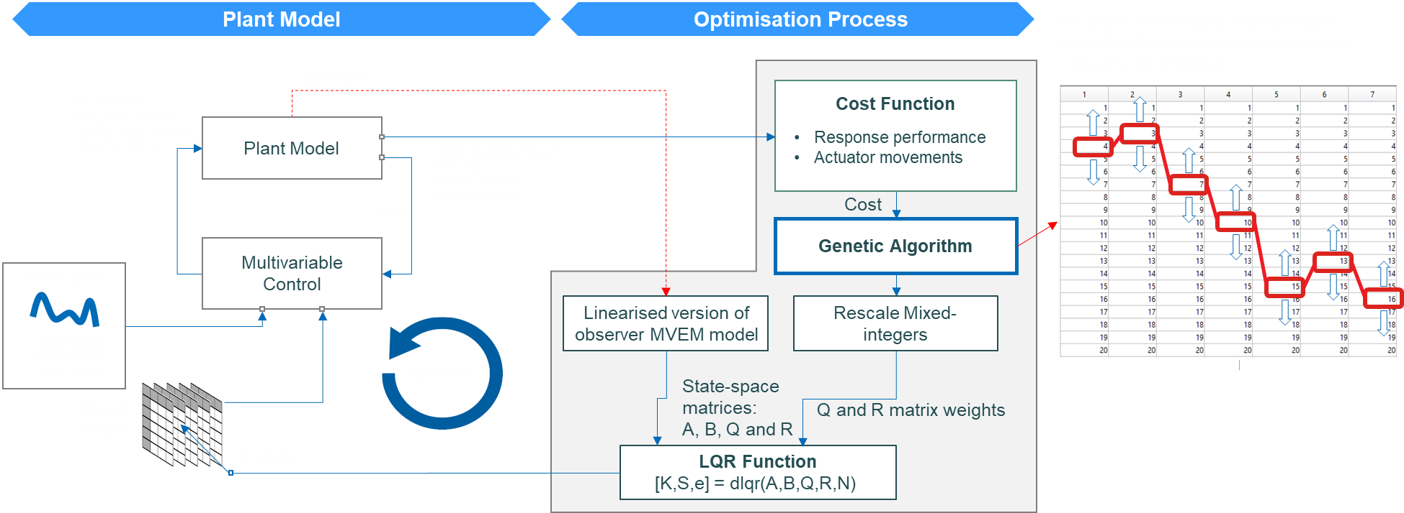
LQR (Linear-quadratic regulator) controller can help to optimise the controller’s feedback gains and ensuring overall stability of the controller but it needs design weights for the LQR which is not easy to get
I have developed a meta-optimisation method to use genetic algorithm optimisation to optimise LQR optimisation weights. The Simulink model consists of a feedforward controller and a plant model.

Slide 13
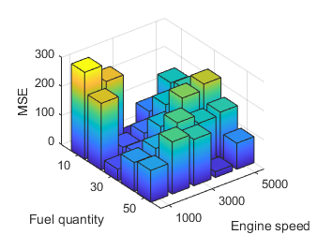


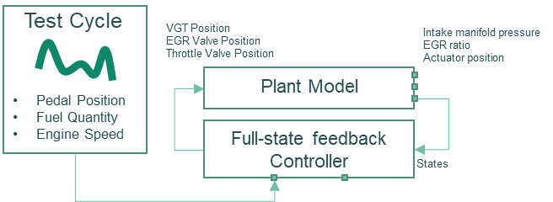
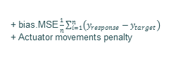
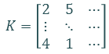
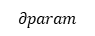
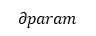
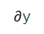
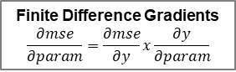
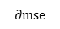
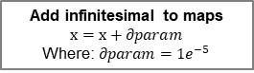
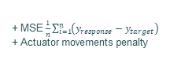

I also helped to optimise another multivariable control gain maps in Simulink using GA and gradient descent optimisation
It is a two-staged optimisation approach for more targeted optimisation
Stage 1: Optimise using GA for all operating points
Stage 2: Fine tune gain map for full test cycle
Load Steps
Test Cycle
VGT Position
EGR Valve Position
Throttle Valve Position
Intake manifold pressure
EGR ratio
Actuator position
VGT Position
EGR Valve Position
Throttle Valve Position
Intake manifold pressure
EGR ratio
Actuator position
Model compiled for processing
Using parallel computing
Plant Model
Target responses
Pedal Position
Fuel Quantity
Engine Speed
Plant Model
Target responses
Operating point selection
Pedal Position
Fuel Quantity
Engine Speed
Multivariable Control
Multivariable Control
States
States
Model evaluation
Gradient Descent Optimisation
Parallel Computing
Genetic Algorithm
Optimisation Process
Gains (integers)
[1,2,6]
Operating point selection
Add infinitesimal to maps
$$x=x+∂param$$
Where: $∂param=1e^{−5}$
Rescale
mixed-integers
Initial
start maps
(from GA)
K-gain maps
$$K=\left[\begin{matrix}2 & 5 & ⋯ \\ ⋮ & ⋱ & ⋯ \\ 4 & 1 & ⋯\end{matrix}\right]$$
K-gain maps
Gradients
Cost, ∑ (Error)
$$∂param$$
$$∂param$$
Maps Interpolation
Min Cost
Image of the model
GA Operators
Mutation
Min Cost
Function Objective
Crossover
Initial load step k-gain maps
+ MSE $\frac{1}{n}\sum_{i=1}^{n}{\left(y_{response}−y_{target}\right)}$
+ Actuator movements penalty
Target responses
Function Objective
Actual responses
Selection
Function Objective
+ bias.MSE $\frac{1}{n}\sum_{i=1}^{n}{\left(y_{response}−y_{target}\right)}$
+ Actuator movements penalty
Finite Difference Gradients
$$\frac{∂mse}{∂param}=\frac{∂mse}{∂y}x\frac{∂y}{∂param}$$
$$∂param$$
+ MSE $\frac{1}{n}\sum_{i=1}^{n}{\left(y_{response}−y_{target}\right)}$
+ Actuator movements penalty
$∂$y
Cost
$$∂mse$$
Interpolated initial k-gain maps

Slide 14
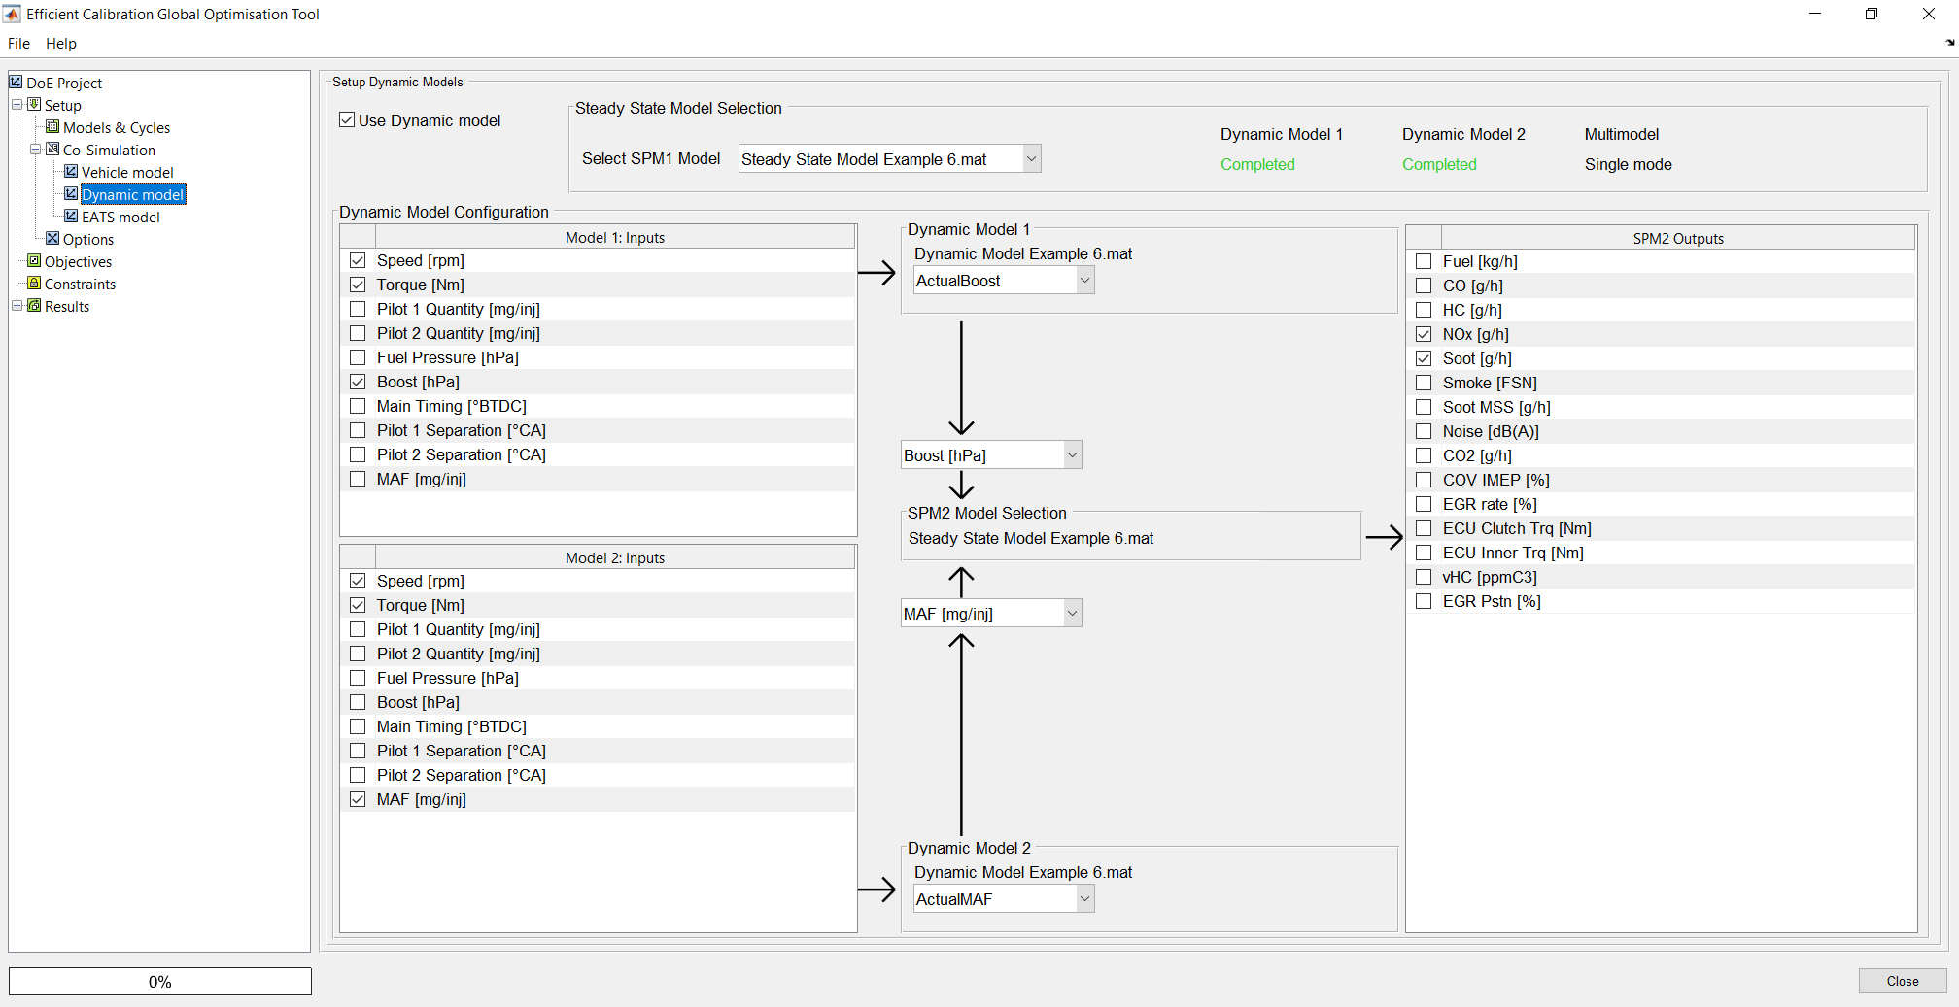
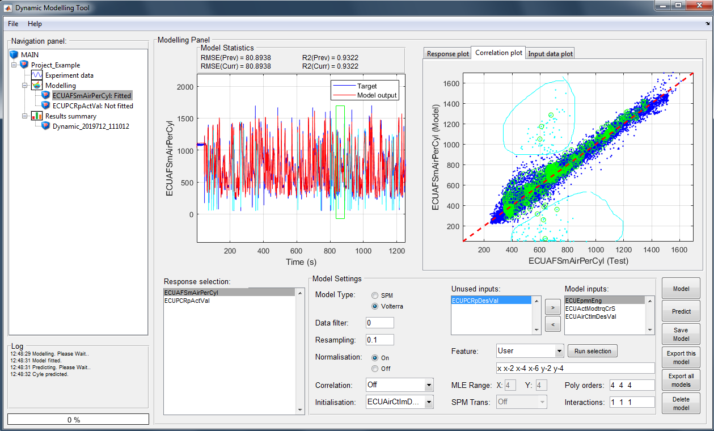

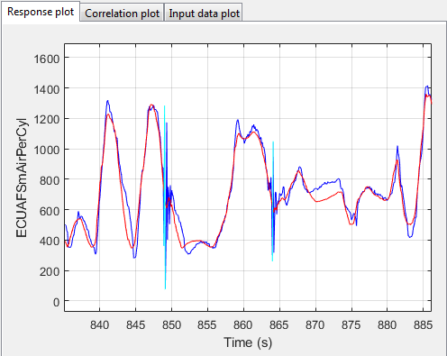
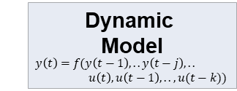
I developed a time-series machine learning model algorithm from scratch to predict air-path dynamics for emissions prediction
Trained dynamic model can be used in our global optimisation or use externally such as Simulink s-function for predicting high dynamic systems
Efficient Calibration Global Optimisation Tool
My product is now integrated in Ricardo’s optimisation tool
I won Ricardo Paper of The Year for the ML algorithm development
Efficient Calibration Dynamic Modelling Tool
Interactive tool
Use in Global Optimisation Tool
Trained Dynamic Model
Command line predictions
Use in scripts or Simulink s-functions for real-time predictions
The cyan line on the main plot is the selected outliers from correlation plot.
yt = spm_dynamic_predict(x,Md);

Slide 15
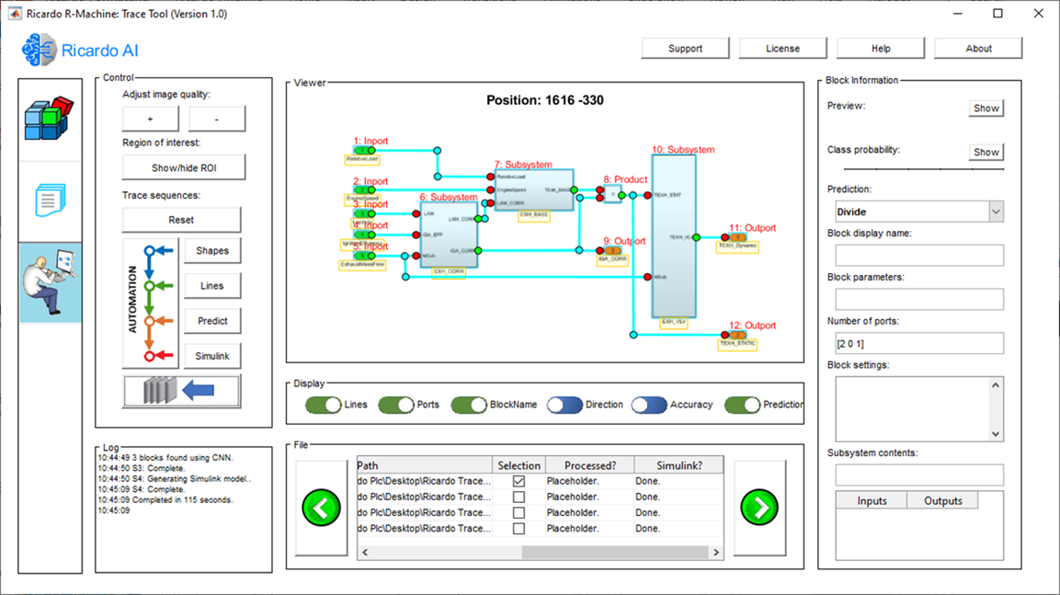
I have developed a tool that can automatically convert strategy images from a PDF document into Simulink models.
By combining a deep learning model, image processing techniques, a robust AI (Artificial Intelligence) line tracking method and OCR (Optical Character Recognition) the tool can identify blocks in images and reconstruct the Simulink models programmatically.
Partially eliminating human labour in recreating a strategy
Trace tool was able to read images and reconstruct a sample model in 116 seconds. In comparison, a human developer needed 685 seconds to do the same task.
I won runner-up Ricardo Phil Hore Engineering Award for invention of the tool.
I’m interactive

Slide 16
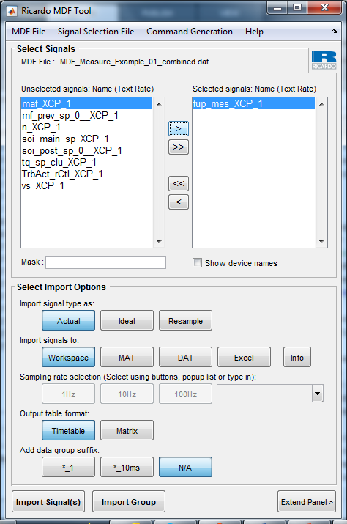
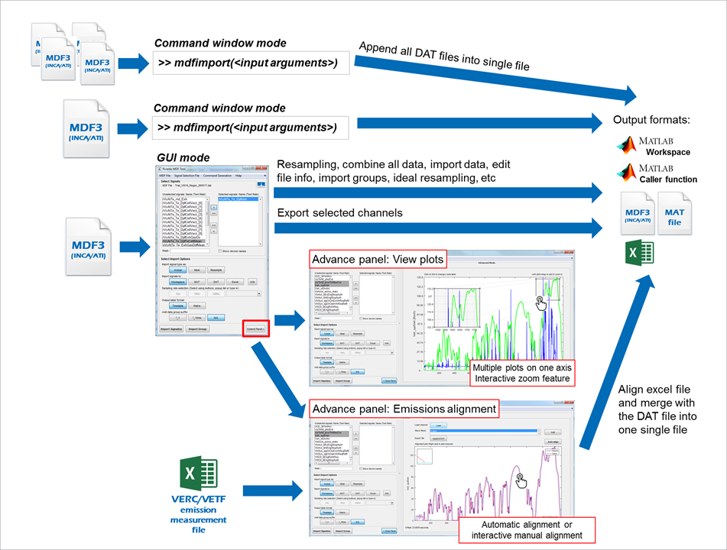
An MDF tool was developed to read vehicle measurement files in MDF format, write data to MDF, append excel data to existing MDF file and align emissions data to measurements file.

Slide 17
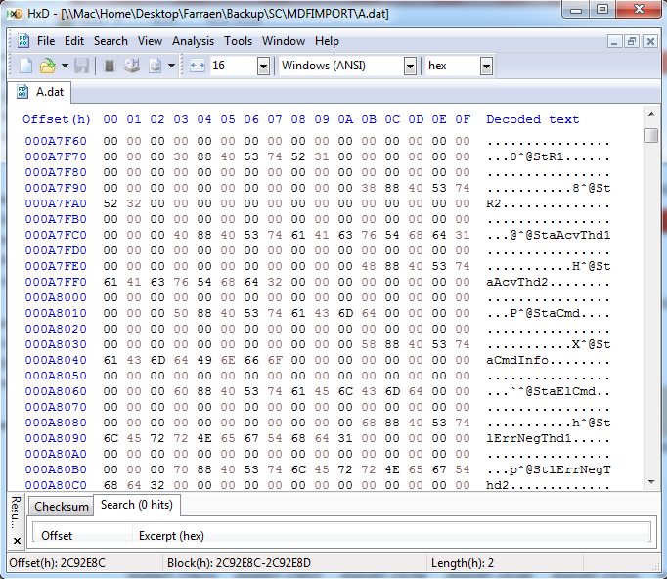
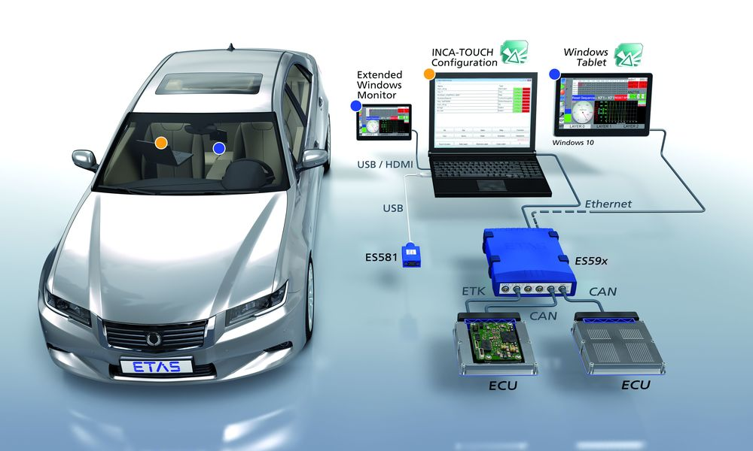
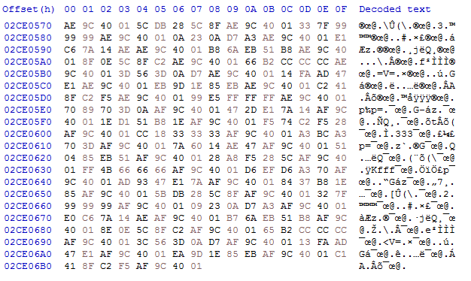
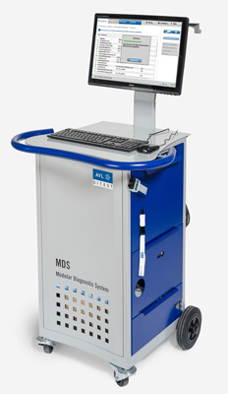
The algorithm I developed to append data to dat file is regularly being used by calibration engineers and it managed to reduce customer complains of having two unaligned recording files.
It took me one week to figure out how to make the appended data group in a binary file to be detected by mdf readers.
* Append process is fast it only append new data group to an existing binary file and just changing the next data group position to make the new data group visible to MDF file reader.
Vehicle Recording
3. Add next DG (data group) position at the last DG (data group)
Emissions Recording
2. Append new data group at the end of the binary dat file
1. Pre-allocate empty spaces in the binary file

Slide 18
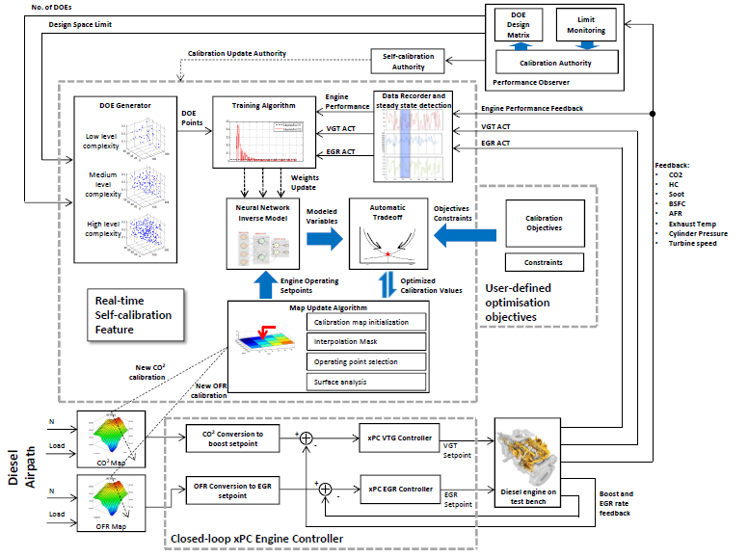
It is a project to reduce calibration effort by automating model based calibration process. The platform which written in s-functions and executed in Simulink can replace calibration engineers doing the repetitive process.
The platform can automatically run an engine, model the response and run optimisation live while the engine is running.
Everything was written from scratch including the machine learning model including the optimisation algorithm. The coding was done this way because the integration will be in a Simulink model within xPC. So everything was kep to minimum and less dependent on advanced toolboxes.

Slide 19
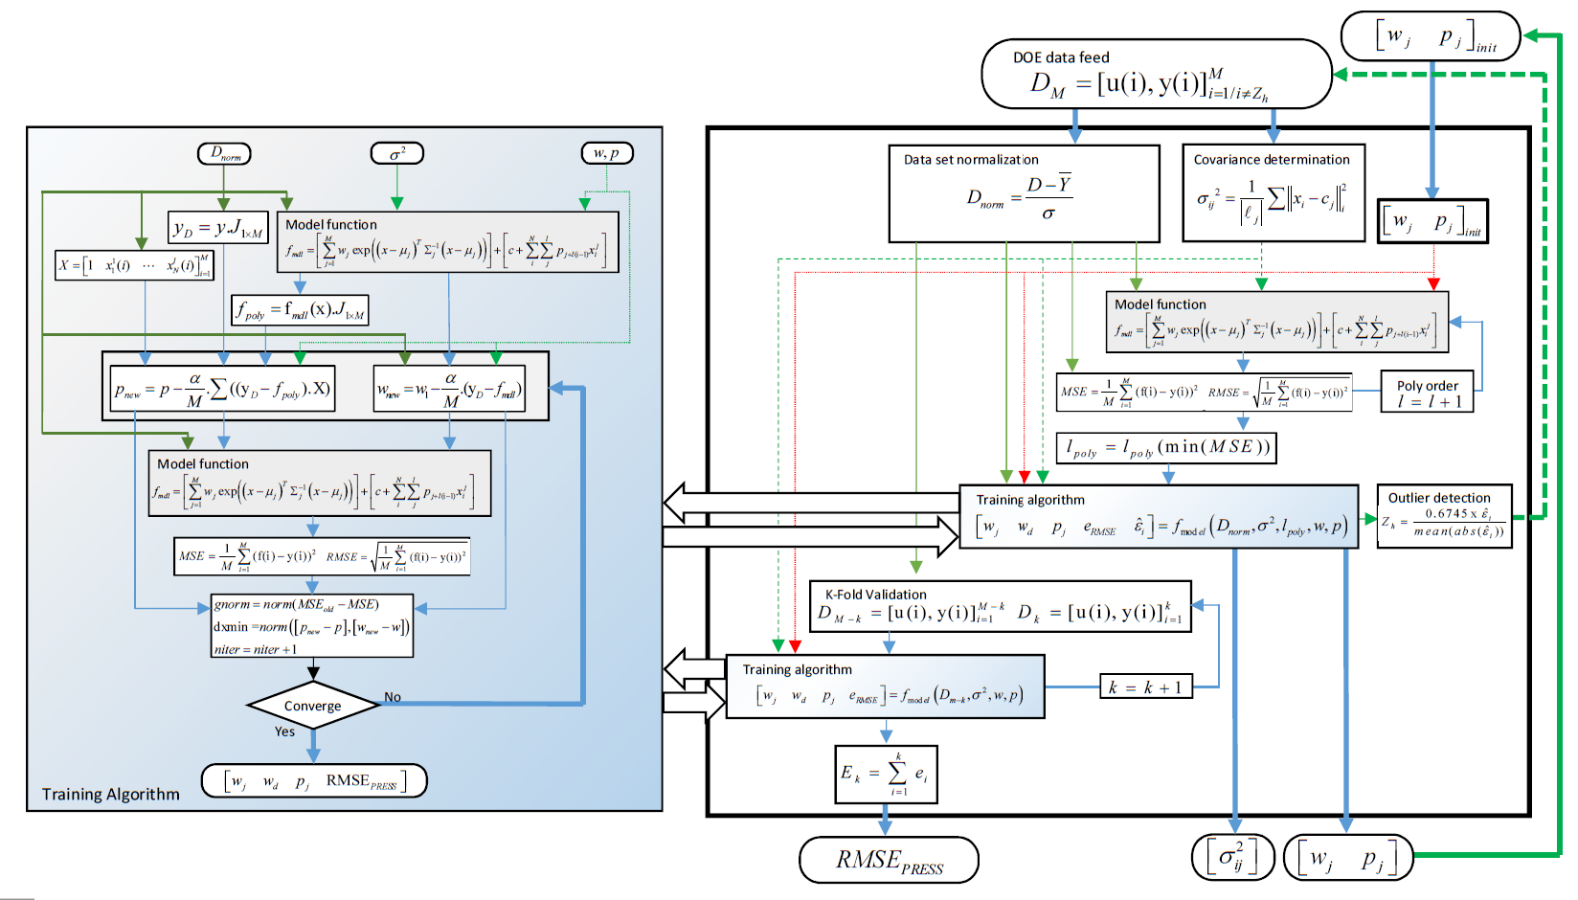
Static model algorithm and its training process custom developed for fast learning process. The diagram shows the developed hybrid radial basis function(RBF) neural network model framework and gaussian process training algorithm.
The ML model was developed from scratch and is structured in a way that can support constructive modelling and can run really fast in a Simulink model.
It can learn new engine data in real-time and run prediction in real-time while the engine is running.

Slide 20
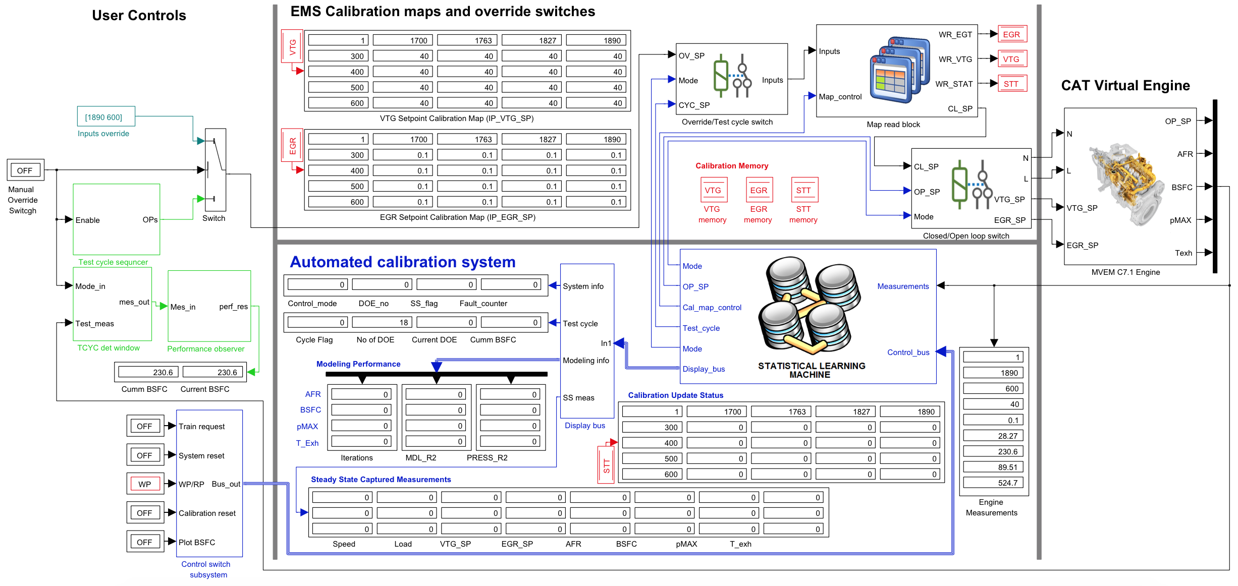
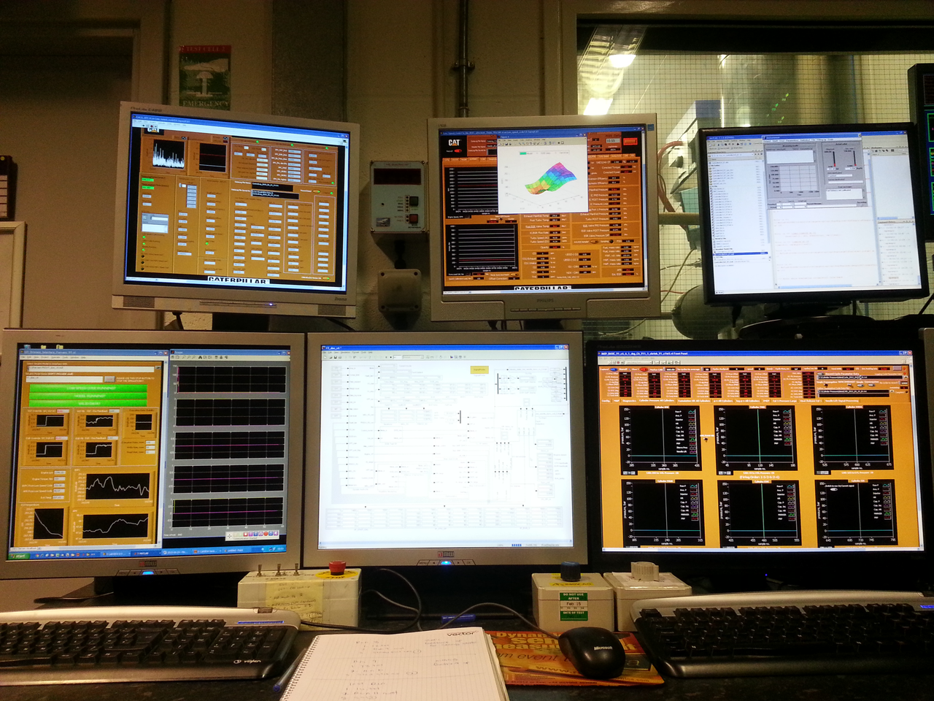
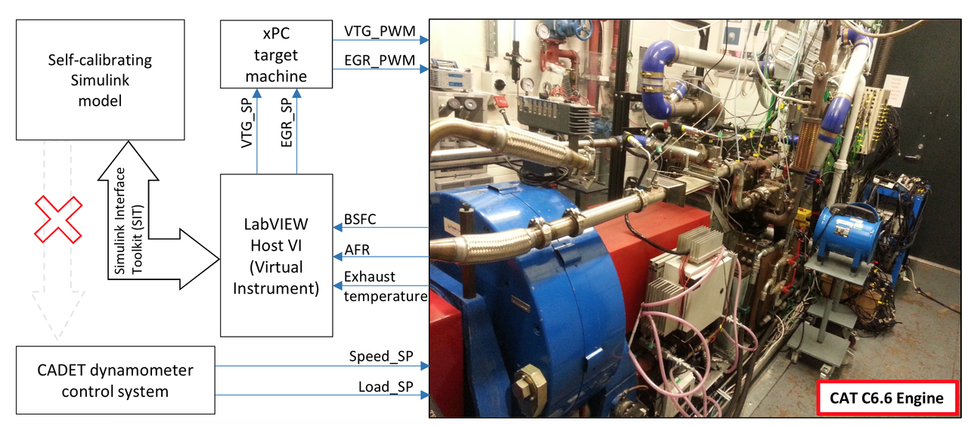
Final automatic calibration system in Simulink. This system can be linked to an actual engine using xpc. This system is tested on an actual diesel engine and has successfully calibrated its VTG and EGR set points. The picture below is the actual Simulink system developed which can take over an engine and run automated calibration process in real time.

Slide 21
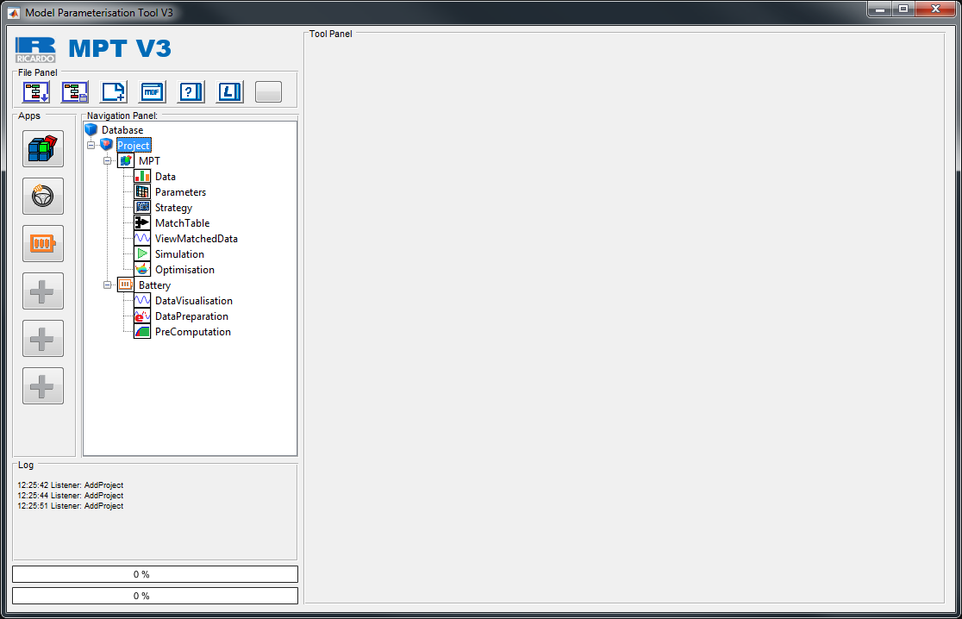
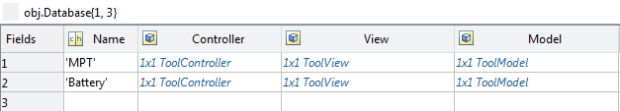
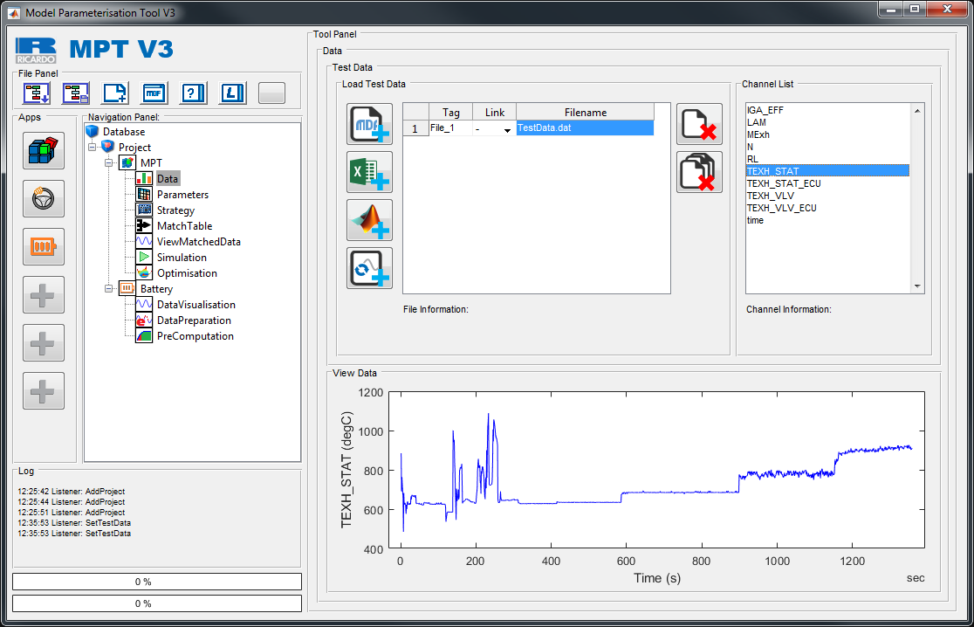
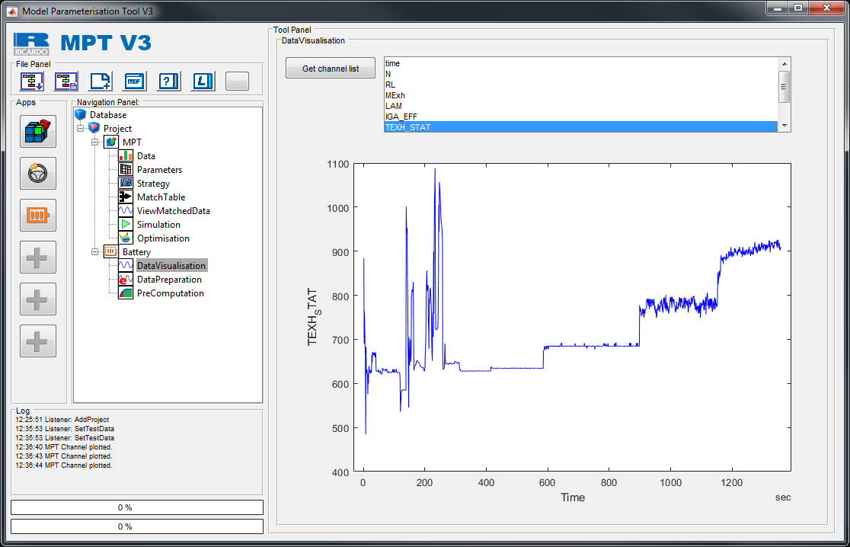
I have developed HMVC (Hierarchical MVC) in Matlab as an extension of the MVC framework to support for larger tool.
For a tool that has the ability to expand its self by adding apps or add-ins, it needs to have an expandable framework. One method is HMVC framework which contains multiple MVCs.
View
Main Tool
Controller
Model
objTool.Gui.ToolPanel
View
RDrive
View
Controller
Model
Batt.
Controller
Model
View
MPT
Controller
Model
Battery App Panels
MPT App Panels
View
Map
Tool
Parent Panel,
Obj.Gui.Figure = objTool.Gui.ToolPanel
Controller
Model
Parent Panel,
Obj.Gui.Figure = objTool.Gui.ToolPanel

Slide 22
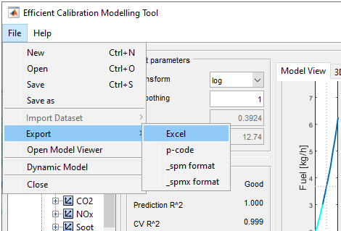
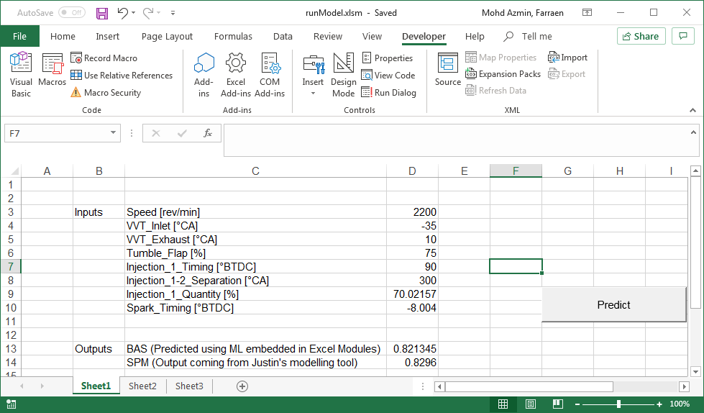
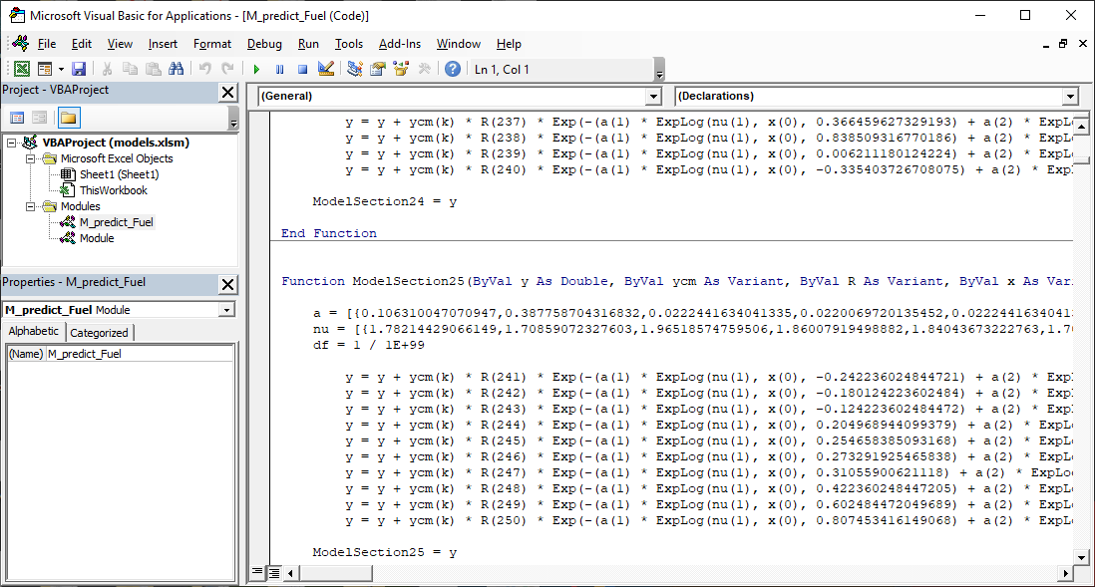
I have written a converter to convert SPM algorithms (a Ricardo ML model) and parameters from Matlab into Excel BAS modules
The BAS modules allow Excel to run SPM models without any special software or toolboxes.
This SPM feature is simple but it shows our capability to make complex algorithms work in a primitive environment that is accessible to others
Modelling Tool
Automatic VBA BAS module and Excel sheet generation from Efficient Calibration Modelling Tool
Engine response predictions in Excel
SPM Model in Excel VBA Module
User can have this excel with embedded ML models. No other tools are required to run the response prediction.
Predictors
Responses
Optimised ML code generation in VBA to prevent memory allocation failure

Slide 23
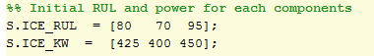
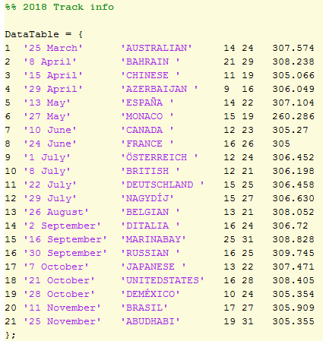
A hobby project to explore application of GA in F1 problems.
Only 3 power units were allocated for each season and the PU from previous season can be used.
An optimiser is developed to make selection which PU to use at each race which can maximise power while maintaining zero failures until end of the season.
The script was written in one day.
Damage Model
Power Loss due to temperature and mileage
GA fills in power units
Optimiser
2018 Track info with race
distance and average ambient
temperature
Allocation for each track in the year
PowerUnit ID
1 | 1 | 3 | 2 | 2 | 1 | 3 | 3 | 1 | 2 | 1 | 1

Slide 24
The optimiser allocated the three PU for each race which maximises engine power while keeping RUL more than 0%.
10 random allocation are generated and the RUL and power reduction is determined. This is then compared to the optimised allocation.
This exercise is only to exploit the use of GA for discrete optimisation problems and help to increase my skills for future tasks.
No | Date | Track | ICE | RUL | Power left
1 | 25-Mar | AUSTRALIAN | 1 | 69 | 421
2 | 08-Apr | BAHRAIN | 3 | 85 | 440
3 | 15-Apr | CHINESE | 1 | 57 | 419
4 | 29-Apr | AZERBAIJAN | 3 | 73 | 439
5 | 13-May | ESPAÑA | 3 | 61 | 435
6 | 27-May | MONACO | 2 | 61 | 397
7 | 10-Jun | CANADA | 3 | 50 | 433
8 | 24-Jun | FRANCE | 3 | 39 | 427
9 | 01-Jul | ÖSTERREICH | 3 | 28 | 424
10 | 08-Jul | BRITISH | 1 | 45 | 416
11 | 22-Jul | DEUTSCHLAND | 1 | 35 | 411
12 | 29-Jul | NAGYDÍJ | 1 | 24 | 406
13 | 26-Aug | BELGIAN | 2 | 49 | 395
14 | 02-Sep | DITALIA | 3 | 17 | 418
15 | 16-Sep | MARINABAY | 2 | 40 | 377
16 | 30-Sep | RUSSIAN | 2 | 29 | 371
17 | 07-Oct | JAPANESE | 1 | 13 | 403
18 | 21-Oct | UNITEDSTATES | 2 | 19 | 364
19 | 28-Oct | DEMÉXICO | 1 | 1 | 400
20 | 11-Nov | BRASIL | 2 | 9 | 357
21 | 25-Nov | ABUDHABI | 3 | 7 | 409

